Slide 1








Electricity Industry National Health and Safety Advisory Committee (HESAC) Update
July 2023

Slide 2
Introduction
The National HESAC last met on 29th June 2023 to discuss Electricity Industry Health and Safety issues. This briefing summarises the key items discussed.
Powering Improvement updates – Work relating to 2023 theme of ‘Promoting a positive health and safety culture’ is progressing well and discussions pertaining to the 2024 Theme have begun with ‘Supporting Workers / Worker Safety’ being of top interest.
National HESAC Terms of Reference/Governance due to be reviewed as current Chair (Lee Wallace, National Grid Electricity Distribution) announces retirement at the end of the year. Gareth Pearson (Northern Powergrid) has offered to take over from Lee later in 2023 to ensure that Company fulfils the objective to Chair over the remaining tenure into December 2024. Affirmed commitment received from all HESAC Participants.
Industry issues raised for wider discussion on items such as: Lone Working, Threats & Violence; & EU Retained Law Reform Bill.

Slide 3
Key Issues Discussed
Powering Improvement (PI)
ENA welcomes feedback that can be fed into the PI corporate memory section of its website to support further sharing of industry knowledge and learning points from historic safety incidents. Staff encouraged to promote corporate memory through regular engagements at Local HESAC and escalate through appropriate communication channels. ENA via its SHE Committee are looking to develop a mechanism to collate incident learning moving forward.
The Powering Improvement Steering Group has set up a subgroup represented by all Network companies and trade unions to deliver the objectives within the ‘promoting a positive health and safety culture’ Delivery Plan for 2023. The subgroup first met in November 2022 with a view to continue to meet once every two months to support the delivery of the key proposed outputs of the 2023 Delivery Plan. The group initially took a review of individual company arrangements as a benchmarking exercise and concluded there were two key areas requiring focus.
To ensure the work progresses sufficiently, the Sub-group has been split to focus on the specified areas to deliver outcomes. One outcome is to produce an Electricity Networks guidance package to support and help ensure constructive and effective ‘Leadership Engagement’ takes place across the sector. It is envisaged that a specific package of material will be developed to be shared with leaders across the sector to support better and more constructive communications to take place during engagements.
The other group is focussing on cultural programmes with the view to produce an Industry ‘Learning Culture’ package which will aim to support a ‘Fair and Just’ approach and understanding across the sector. This will reach further than simply incident investigation and aim to look and support how both the organisation and its people are held accountable while focusing on risk, systems design, human behaviour, and safety.
This work will be continued throughout 2023 and into 2023 with the outputs delivered on priority of value added.
Chris Burchell (Managing Director of Scottish and Southern Electricity Networks Distribution) is the Powering Improvement Champion and delivered a presentation at ENAs SHE Management Conference on the 24th and 25th May 2023 in Dublin, hosted by ESB Networks.
Occupational Health Management
ENAs Occupational Health Committee has undertaken a review of the Powering Improvement Occupational Health Roadmap which it will be looking to relaunch late summer. The main Roadmap has been updated with the next critical steps to conduct a review of all content presented via the map and ensure that it promotes recent best practice advice on the variety of occupational health risk topics experienced and managed within the energy sector.
The Electricity Networks companies across UK and Ireland via ENA has launched the EFRIN Project (Exploring Fatigue Risks in Electricity Networks) in partnership with Hull University and the centre for Human Factors. Operational Staff across the UK and Ireland will take part in a series of workshops starting in July which will focus on the principles and understanding of Fatigue. Feedback and insight from the workshops will help to inform phase 2 to support the development and production of a series of Training Packages for managers and frontline staff.

Slide 4
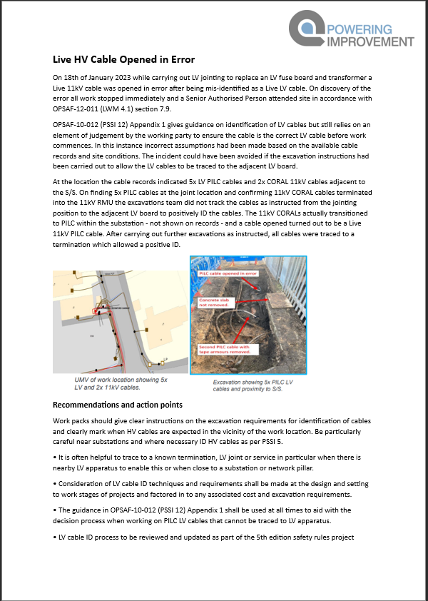
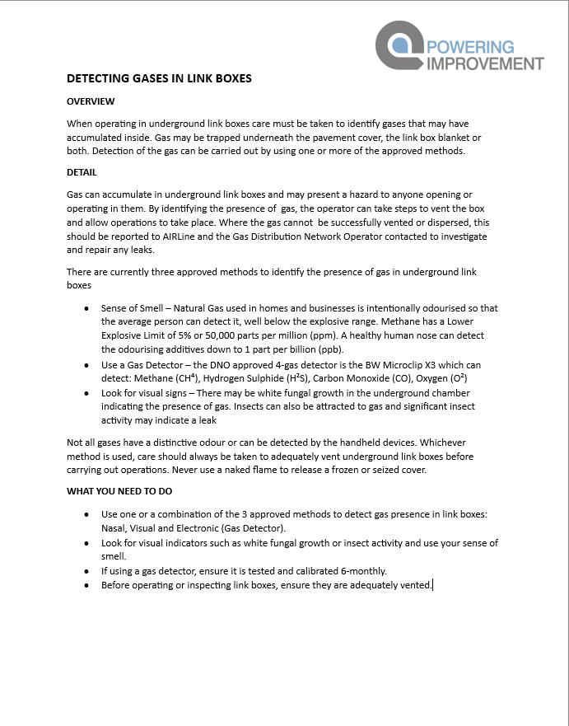
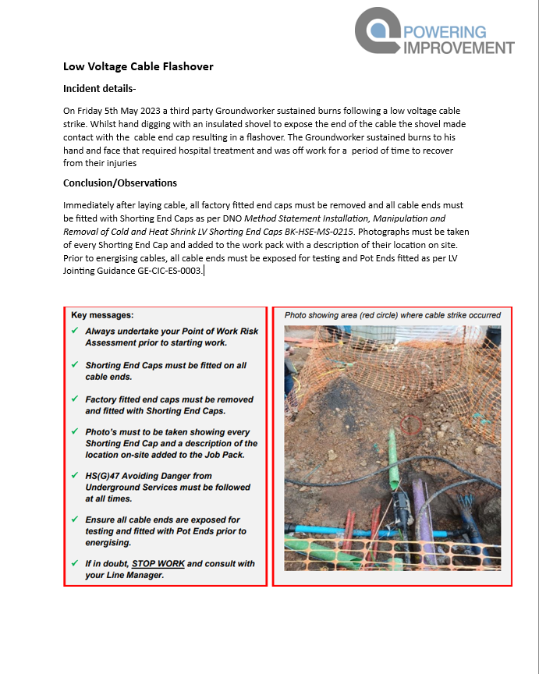
PI SHE Bulletins (click to expand)
Please use to generate discussion during team briefs or Local HESACs

Slide 5
ENA Progress Update
ENA Health and Safety Management
Operational Safety – The review of ENA SHE Standard 01 – Live working on LV Distribution systems is underway. There is a view that increased awareness and promotion of best practice advice is needed. The group are looking to deliver a consistent set of principles and reference material which will support company training and briefing actions on principles of live working.
Occupational Safety – The group are undertaking a review and conducting a risk maturity matrix on some key occupational safety risk areas such as: Driving and Road Risk, Lone working, Workplace Violence and Harassment and Asbestos management. The group is also developing a high-level position paper on ‘working on or near water’, reviewing policy arrangements surrounding Driving and Road Risk and on the management of Lone Working.
Occupational Health –EFRIN Project launched (Exploring Fatigue Risks in Electricity Networks). Looking at ways to capture and benchmark industry health metrics.
Public Safety – The group is facilitating a Stakeholder engagement conference which will be held in Birmingham on the 21st September 2023 at BCEC registrations will be available soon via the ENA website. The event will seek to engage with wider industry partners and stakeholders to engage on the dangers associated with energy network infrastructure with an aim to further promote awareness and safety advice (electricity overhead powerlines and underground utility assets).
Training and Competency – ENA is producing a high-level position paper on refresher training needs for operational staff within the electricity networks sector. ENA will continue to work with interested stakeholders (Trade Unions and Regulators) to ensure Networks commitments to meet future skills requirements are met in support of the National Skills Academy for Power (NSAP) and EU Skills Programmes to ensure an efficient and coordinated approach is adopted across the sector to address implications of Net Zero challenges on existing and future skills and competencies. Including the consideration of workforce resilience and Equality, Diversity and Inclusivity.
ENA Environmental Management
Environment - ENAs PCB Strategy Group has successfully developed its Statistical Cohort Modelling tool onto a cloud-based system. Significant progress is being made by individual companies to sample Transformers with an aim to continually remove non-contaminated assets from the Environment Agencies registers. To date approx. £550M of asset replacement work has been avoided due to the statistical modelling work.
ENA continues to engage and support Streetworks UK into the development of a utility wide solution to suitably risk assess waste from excavated spoil for unplanned operations (RPS211 replacement). A protocol and enhanced risk assessment process that has been supported by the Environment Agency is being refined and developed that will ensure that waste can be sufficiently classified and segregated to support the sector in its requirements.

Slide 6
Trade Union Update
Local activity
Unions continue to work at company level on priority issues including fatigue, corporate memory and stress/mental health. Examples include:
• Working with employers to help prepare for and facilitate the ENA’s upcoming fatigue management initiative EFRIN
• Working with a DNO employer to develop a corporate memory repository to capture lessons learnt from incidents and accident in an easily accessible place. Corporate memory is a priority issue for the industry and a core element of Powering Improvement.
• Working with a renewables employer to improve standards of contractors. The union is concerned that high-risk activities are outsourced to contractors that do not share the same high standards as the client.
•Working with a renewables employer to better support and promote employee mental health and helping to introduce wellbeing ambassadors to the company.
• Working with a DNO employer on a safety culture improvement programme, one facet of which is overhauling the business’s approach to people management.
National events
Prospect held its energy sector conference on 23 May – a biennial policy conference for Prospect reps working in the electricity and nuclear industries. There were resolutions addressing a number of health and safety issues, including the effect that fault response targets have on members’ health and wellbeing; welfare facilities; and fatigue. In the coming weeks the union’s sector executive committee will establish how it will take forward these resolutions, which will likely include raising them at appropriate forums.
The Prospect energy sector conference featured a breakout session on health and safety culture in support of the current theme of Powering Improvement. It was led by a member of Prospect’s air traffic control officer’s branch and addressed how the union had worked jointly with the employer to develop and implement a positive health and safety culture.
Prospect held its biennial health and safety conference on 25 April. The theme was the 50th anniversaries of the Health and Safety at Work Act and Robens report, and their contemporary relevance to the union. The keynote speaker was Kevin Myers, who held a number of roles at the HSE, including deputy chief executive, chief inspector of construction and the director hazardous installations.
There was also a panel discussion which reflected on the post-pandemic workplace, labour market and worker health.
Wider policy work
Prospect HSE report
Prospect, which represents HSE inspectors, policy staff and scientists, recently published a report detailing the staffing and funding crisis which is engulfing the HSE. Internal data and findings are shown in HSE under pressure: A perfect storm.
EU retained law bill update
Unions have continued to campaign against the Retained EU Law (Revocation and Reform) Bill. The government has removed the “sunset” clause from the Bill – which could have removed thousands of laws from the statute book on 31 December – and reduced the number of laws set to be axed from over 4,000 to 600.
Nevertheless, unions are concerned that the government is pressing ahead with deeply troubling changes to the Working Time Regulations and other employment laws, and that the bill still grants Ministers wide powers and streamlined mechanisms to revoke, revise or replace any retained EU law remove laws without proper scrutiny.
.

Slide 7
Energy UK Update
Energy UK’s Health and Safety Sub-committee (EUK H&SSC) last met on 19 April.
The H&SSC discussed the risk of losing key health and safety measures if the Retained EU Law (Revocation and Reform) Bill is not sensitive to this. The sub-committee also discussed risks relating to sub-contractors whose suite of policies may not retain all of the measures currently set in EU law. Following this discussion, the H&SSC contributed to Energy UK’s work to influence the government’s work on the Bill.
The EUK H&SSC also shared information on particular incidents/issues including working at height, abuse of staff, dog bites, slips and trips as well as driving safety.
The EUK H&SSC next meets on 12 July 2023.
.

Slide 8
Performance Comparison 2022 vs 2023
Notes:
Significant increase in the total recordable incident rate per 200,000 hours from Q1 2022 to Q1 2023. Worrying trend.

Slide 9
Conclusion
We hope that this is a useful overview of the issues considered by national HESAC and welcome feedback from local Committees, both on the detail of local initiatives and on any additional items that you believe we should address.
For further information on the items within this briefing, a full set of minutes of the meeting held 9th February can be found on the Powering Improvement website - www.poweringimprovement.org/national-hesac/
For further information, please engage with your respective local or national HESAC representative.
Next Meeting
The next meeting of National HESAC is on September 28th 2023.
Jamie Reeve
Secretary to National HESAC
Energy Networks Association

